Slide 1
Empowering the Future: Cyber Software Development Academy Center Partnership Proposal
Presented by James Christian Hill

Slide 2
Connecting with St. Louis Public School
Engagement and Impact
As an education enthusiast, I have been actively involved with the St. Louis Public School district for the past 5 years. My experience includes helping develop innovative curriculum strategies that cater to diverse student needs.
Through my volunteer work, I have organized various community events to raise awareness and funds for improving school facilities, such as libraries and playgrounds. These initiatives have positively impacted the overall learning environment.
Collaborating closely with teachers, I have facilitated workshops on integrating technology into classroom instruction. This has enhanced student engagement and fostered a deeper understanding of the curriculum.
Additionally, I have mentored students to cultivate leadership skills and encouraged their participation in extracurricular activities. It is my belief that holistic education goes beyond academics, empowering students to thrive both inside and outside the classroom.
Photo by Pexels

Slide 3
Demand for Software Development Education
Positive Implications
Negative Consequences
Software development is a thriving industry with a growing demand for skilled professionals.
Acquiring software development skills opens up numerous job opportunities and high earning potential.
Meeting the demand for software development education prepares future generations for job market success.
Lack of software development education creates a skills gap in the tech industry.
The skills gap hinders technological innovation and economic growth.
Without dedicated centers for high school students, many young talents are overlooked and labeled as unqualified.

Slide 4
Alambda Overview
Expertise in Software
Alambda has a rich history and background in software development, with experience spanning over a decade.
Our team of experts has a deep understanding of various programming languages, frameworks, and technologies.
We have successfully delivered numerous software projects, ranging from small web applications to large enterprise solutions.
Our expertise includes but is not limited to backend development, frontend development, database management, and DevOps.
Photo by Pexels

Slide 5
Lambie: Our Solution
Unique features
Lambie is a comprehensive software development education platform.
Unique features include interactive coding exercises and project-based learning.
Lambie offers real-time feedback and personalized learning paths for students.
Hands-on experience with Lambie prepares students for real-world software development challenges.
Photo by Pexels

Slide 6
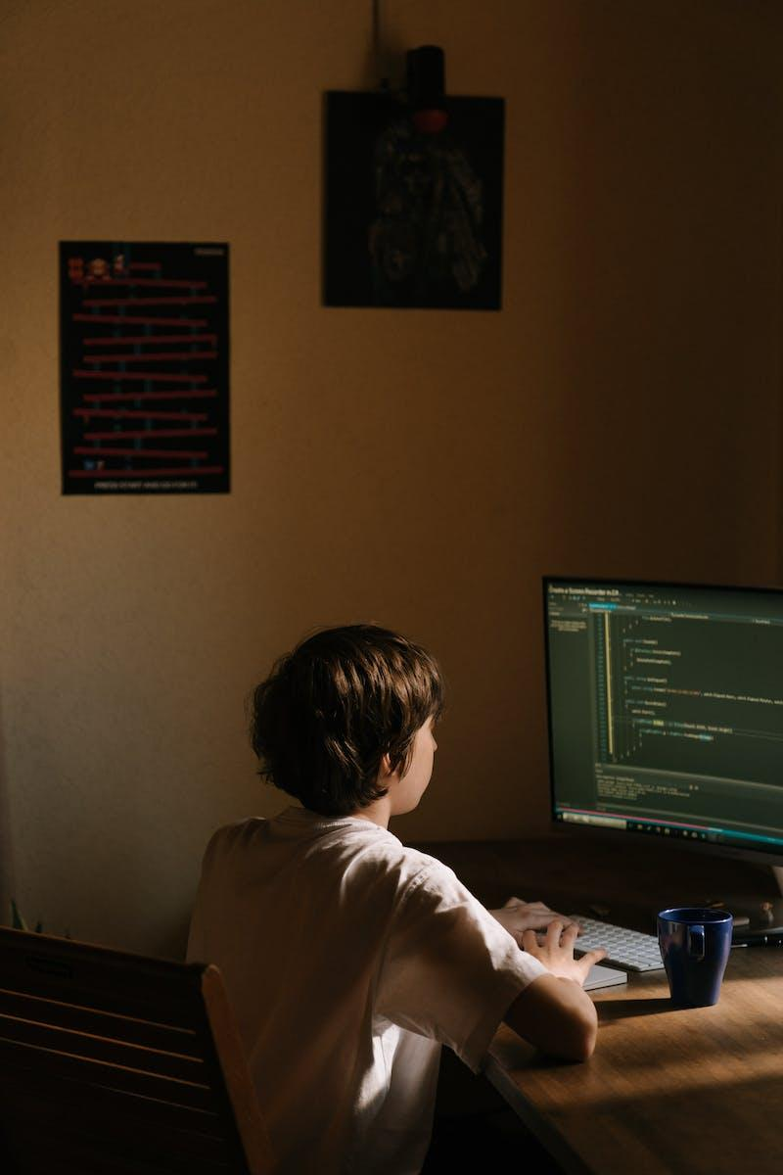
Cyber Software Development Academy Center at T-Rex
Vision: Curriculum and Training Program
Our vision for the Cyber Software Development Academy Center at T-Rex is to provide comprehensive training in cyber software development.
The curriculum will cover a wide range of topics including cybersecurity, programming languages, and software development methodologies.
We will offer hands-on training with real-world projects and practical exercises to ensure students gain practical skills.
Classes will be held for a duration of 12 weeks, with sessions conducted twice a week for 3 hours each.
Photo by Pexels

Slide 7
Resources Needed
Equipments, Software, Facilities
We require computers with high processing power and ample storage capacity to handle data-intensive tasks.
Specialized software such as Adobe Creative Suite and AutoCAD are essential for design and creative projects.
Access to a well-equipped multimedia room with audio and visual facilities is necessary for presentations and workshops.
A reliable internet connection is crucial for online research and collaborative work.
Photo by Pexels

Slide 8
Benefits of St. Louis Public School District
Empowering Students, Inspiring Community
The St. Louis Public School District offers excellent academic programs and resources, ensuring a high-quality education for students.
The district focuses on personalized learning and individualized attention, fostering student growth and success.
By partnering with local organizations and businesses, the St. Louis Public School District creates opportunities for students to develop real-world skills and experiences.
Investing in education through the St. Louis Public School District not only benefits students but also strengthens the community as a whole.
Photo by Pexels

Slide 9
Impact on Education
Transforming Future Careers
The academy center provides comprehensive training in software development, equipping students with essential skills and knowledge.
Students gain hands-on experience through practical projects, preparing them for real-world software development challenges.
The center offers mentorship programs, connecting students with industry professionals who provide guidance and support.
By bridging the gap between academia and industry, the academy center enhances students' employability and future prospects.
Photo by Pexels

Slide 10
Partnership Agreement
Operating Roles & Responsibilities
Clarify the roles and responsibilities of each partner involved in the partnership.
Define the specific tasks, duties, and obligations of each partner.
Ensure clear communication channels and decision-making processes.
Agree on conflict resolution procedures and dispute resolution mechanisms.
Photo by Pexels

Slide 11
Next Steps
Proceeding with Partnership
Suggest the following steps to proceed with the partnership.
Encourage questions and discussions.
Schedule a follow-up meeting if needed.
Photo by Pexels

Slide 12
Conclusion
Excited for the Project!
We have discussed the main points of the proposal, highlighting its benefits and potential.
The proposal addresses key challenges and offers innovative solutions.
Extensive research and analysis support the feasibility and success of the project.
The overall impact of the proposal will be significant and lead to positive outcomes.
Photo by Pexels

Slide 13
Q&A and Discussion
Ask, Discuss, Engage
Open the floor for questions and discussions.
Address any queries or concerns from the audience.
Encourage active participation and conversation.
Promote an interactive and engaging environment.
Photo by Pexels

Slide 14
Thank You
Gratitude & Contact Info
Expressing our sincere gratitude for your time and consideration.
Should you have any further inquiries or wish to discuss in detail, please feel free to contact us.
We value your feedback and look forward to hearing from you.
Thank you once again for your attention and interest.
Photo by Pexels

